Slide 1
The Catholic church in the modern era
Setting the Foundation for the Papacy of JPII
Pope John XXIII • The Second Vatican Council • Pope Paul VI

Slide 2
Timeline Assignment
Over the next week or so, note significant events on your timeline. State the date (year) of the event and draw a picture or a symbol that is relevant for the event.
Secular History on the top half
Church History on the bottom half
 | 4 | 3 | 2 | 1
Documentation of Events | The timeline contains at least 10 significant secular events and 10 significant Roman Catholic Church events. | The timeline contains at least 8-9 significant events each of secular and Church history. | The timeline contains at least 6-7 significant events each of secular and Church history. | The timeline contains less than 5 significant events of secular and Church history.
Accuracy | All dates indicated on timeline are correct and are sequenced in the proper order. | Most of the dates are accurate or sequences are in the proper order. | Some of the dates are accurate or sequences are in the proper order. | Many of the dates are inaccurate or sequences are not in the proper order.
Pictures/Symbols | All graphics are effective, relevant, and esthetically pleasing. | All graphics are relevant. | Some graphics are effective and others are missing/ ineffective. | Several graphics are not effective/ missing.
Legibility/Mechanics | Neat and legible printing. Punctuation, spelling, and capitalization are correct throughout. | Mostly neat and legible. Punctuation, spelling, and capitalization are mostly correct. | Writing is not legible in places. Frequent errors in punctuation, spelling, and capitalization. | Writing is not legible. There are many punctuation, spelling, and capitalization errors.

Slide 3
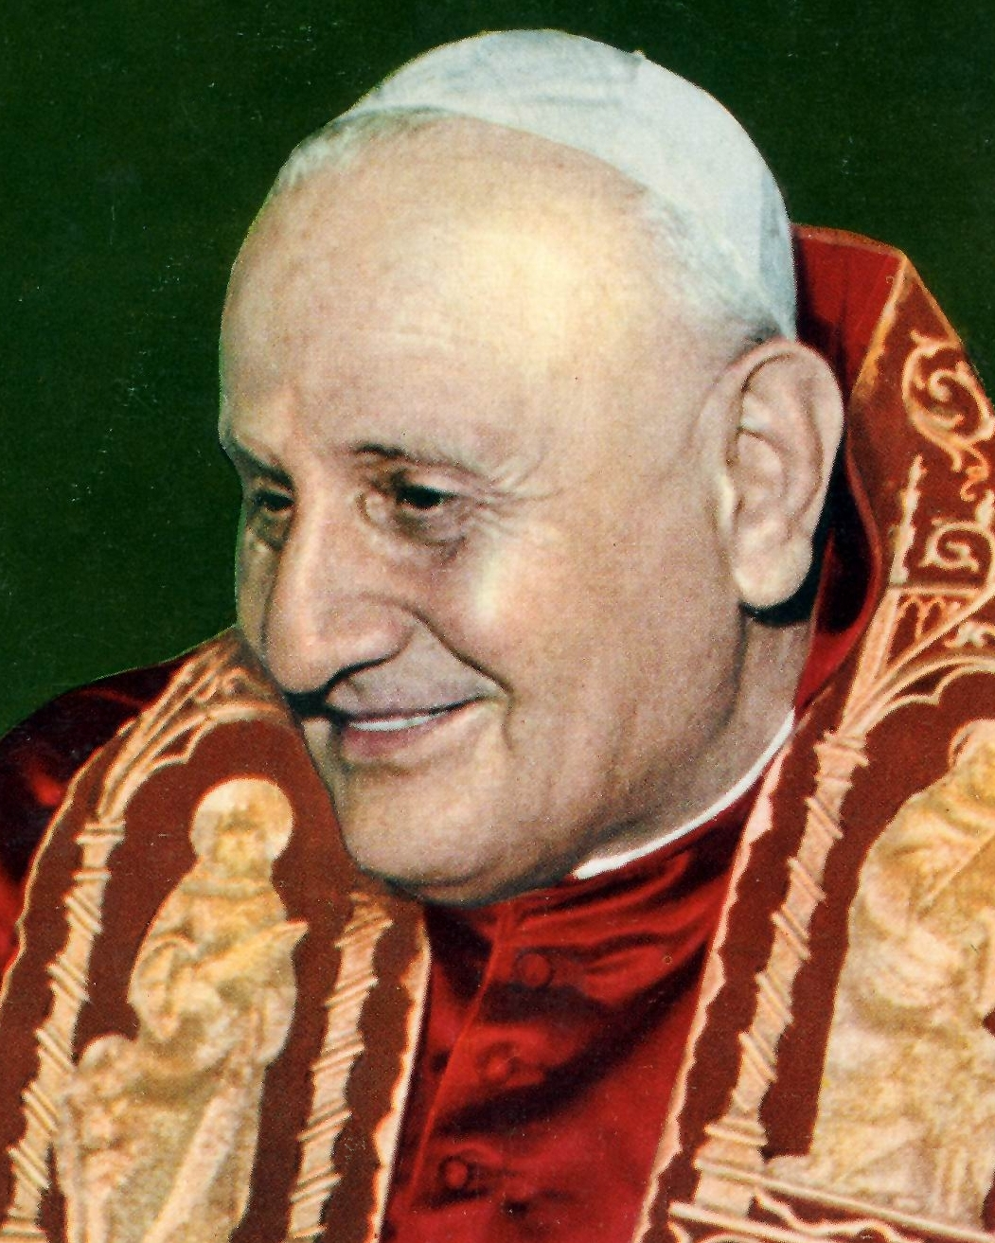
Pope John XXIII
The Caretaker Pope
1958-1963

Slide 4
Good Pope John
elected in his 70s as a “caretaker” pope
was quite the opposite
He immediately made progressive changes:
College of Cardinals increased from set number of 70 to become more of an international body.
He initiated drafting of new Code of Canon Law
He was highly concerned with promoting ecumenism (unity between Christian Churches) and good relations with Jews
Proponent and influence for peace on earth during the time of the Cold War.
Publicly and behind the scenes.
He released his encyclical “Pacem in Terris” (Peace on Earth) just months after the Cuban Missile Crisis began (1963) - USA and USSR on brink of war

Slide 5
Good Pope John
He called an Ecumenical Council in Rome:
The Second Vatican Council (1962-1965)
What is an ecumenical council?
Ecumenical Council: …a meeting of bishops of the whole church... According to Roman Catholic doctrine, a council is not ecumenical unless it has been called by the pope, and its decrees are not binding until they have been promulgated by the pope. Decrees so promulgated have the highest authority in the Roman Catholic Church.” (Britannica)
“Vatican II” is the 21st of such councils in history of the Roman Catholic Church.
The first?
Council of Nicaea – 325
The Second Vatican Council was called for a number of reasons:
the most prominent one being to modernize it. The Church was strong and unified at this time; the Council would help the Church modernize and reach out to address the urgent needs of a world in spiritual poverty (due to war, communism, poverty, human rights issues, etc., etc.)
Pope John only attended the first of four sessions of the council; he died of stomach cancer in 1963.

