Slide 1
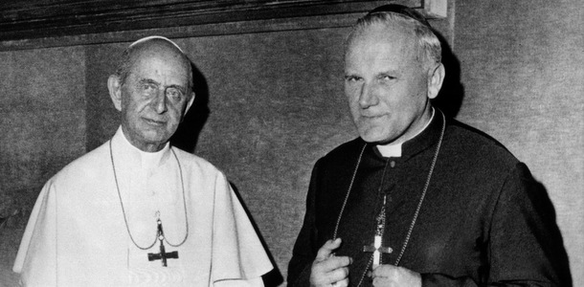
Pope Paul VI
Pope from 1963-1978
Appointed JPII a cardinal in 1967.
He is known for:
Being the most traveled/visible Pope (until Pope JPII).
Ostpolitik : Vatican policy which sought to improve relations with Communist European countries
Seeing Vatican II to it’s conclusion and directing its implementation.
Significant contributions to Mariology (theological understanding of Mary and Marian devotions).
He regarded "devotion to the Mother of God as of paramount importance in living the life of the Gospel."[
The encyclical: Humanae Vitae

Slide 2
Pope Paul VI and Vatican ii
Pope Paul VI saw Vatican II to it’s conclusion and directed its implementation.
Reforms on all areas of Church life
He directed more reform implementation than any other popes before or after him because Vatican II brought so much change.
Ex. instructed on how to change liturgy
Ex. committed to Christian unity – with Orthodox Church and Protestant Churches
Ex. established Synod of Bishops (to express the collegiality between all bishops with pope)
bishops gather in Rome every few years to discuss issues, make recommendations for papal documents
Unfortunately, (even to this day!) there is confusion, misinterpretation, and dissent regarding the council.

Slide 3
Vatican II
1962-1965
16 documents total:
4 Constitutions (the central documents of the council that form foundation for all other documents)
9 Decrees
3 Declarations

Slide 4
Themes of Vatican II Documents
The Church as Sacrament: sign of Christ’s salvation to humanity
The Church as Servant: especially service to those who are suffering
The Church as Communion: Interconnectedness of Humanity/The Body of Christ
Dignity of the Human Being

Slide 5
16 Documents of Vatican ii
1. Sacrosanctum concilium, Constitution on the Sacred Liturgy, 1963. 2. Inter Mirifica, Decree On the Means of Social Communication, 1963. 3. Lumen Gentium, Dogmatic Constitution On the Church, 1964. 4. Orientalium Ecclesiarum, Decree On the Catholic Churches of the Eastern Rite,1964. 5. Unitatis Redintegratio, Decree on Ecumenism, 1964. 6. Christus Dominus, Decree Concerning the Pastoral Office of Bishops In the Church,1965. 7. Perfectae Caritatis, Decree On Renewal of Religious Life, 1965. 8. Optatam Totius, Decree On Priestly Training, 1965. 9. Gravissimum Educationis, Declaration On Christian Education, 1965. 10. Nostra Aetate, Declaration On the Relation Of the Church to Non-Christian Religions, 1965. 11. Dei Verbum, Dogmatic Constitution On Divine Revelation, 1965. 12. Apostolicam Actuositatem, Decree On the Apostolate of the Laity, 1965. 13. Dignitatis Humanae, Declaration On Religious Freedom, 1965. 14. Ad Gentes, Decree On the Mission Activity of the Church, 1965. 15. Presbyterorum Ordinis, Decree On the Ministry and –p[0;Life of Priests, 1965. 16. Gaudium et Spes, Pastoral Constitution On the Church In the Modern World,1965.

Slide 6
Sacrosanctum concilium, Constitution on the Sacred Liturgy, 1963
The liturgy (mass) is “the summit toward which the activity of the Church is directed…”
The liturgy is central to the Church's whole life & mission: through it we are caught up the Paschal Mystery, God's saving plan in Christ. (http://www.olshweston.org/pandj/Vatican%20II%20Themes%20Revisited.pdf)
Calls for “full, conscious, and active participation” in the liturgy.
Mass could now be said in the vernacular.
Priest now faces congregation during liturgy of the Eucharist.

Slide 7
Lumen Gentium, Dogmatic Constitution On the Church, 1964.
“Light of Nations”
“The Church is the Body of Christ”
The Church is a Sacrament to the world: a visible structure, a community of faith, hope, and love, with a mission to proclaim the kingdom of God.
All members of the Body of Christ are equal in dignity and rights, with different roles.
Affirms the important role of the laity.
“Universal Call to Holiness”
All members are called to holiness; all are called to be saints.
Including the laity (not just priests and religious!)

Slide 8
Dei Verbum, Dogmatic Constitution On Divine Revelation, 1965.
Divine revelation comes scripture and tradition which are not two separate entities, but one deposit of faith called “The Word of God” entrusted to the Church.
One can have a personal encounter with revelation.
Authentic interpretation entrusted to the Church alone.

Slide 9
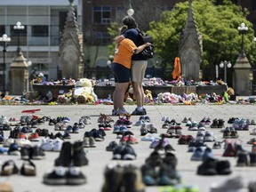
Gaudium et Spes, Pastoral Constitution on the Church in the Modern World, 1965.
“Joy and Hope”
The Church has the duty to examine the signs of the times and interpret them in the light of the Gospel.
Beautiful declaration of human dignity; the Church is to proclaim and defend this in the culture of current time.
Affirms that the Church is at the service of the world, especially those who are suffering.
Discusses:
Common good
Social justice and economy
Marriage and the family
Evangelization
Politics
War and peace
Sanctity of human life
Then HOW?
https://nationalpost.com/news/canada/canadian-catholic-bishops-apologize-unequivocally-for-residential-schools
https://globalnews.ca/video/8002836/indigenous-priest-reflects-on-family-ties-to-residential-schools-and-the-catholic-church

Slide 10
PRIMARY SOURCE Excerpts from Vatican II
Assignment
In small groups:
Read the excerpts from Vatican II (one per group member).
In them, find evidence of the overarching themes of Vatican II.
On a piece of paper, state the themes and evidence for each theme you find in the excerpt
Report a summary and your themes/evidence to your group.

Slide 11
Themes of Vatican II Documents
The Church as Sacrament: sign of Christ’s salvation to humanity
The Church as Servant: especially service to those who are suffering
The Church as Communion: Interconnectedness of Humanity/The Body of Christ
Dignity of the Human Being

